Slide 2
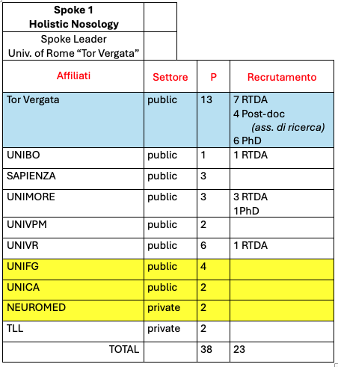
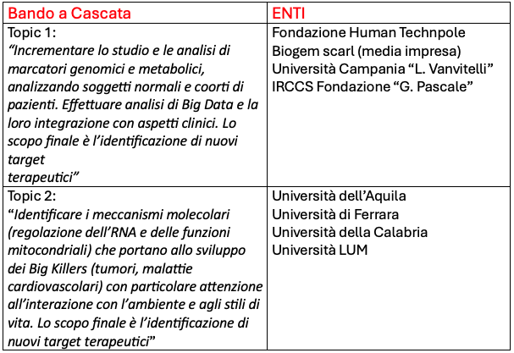
SPOKE 1 Holistic Nosology
From patients to molecules and back. Mapping the omics landscape of the clinical and molecular environment, to identify, classify and refine multifactorial disease.
SPOKE 1 PRESENTATION
Scientific coordinator Prof.ssa Eleonora CANDI
(Prof. Gerry MELINO advisor)
Deputy scientific coordinator Dott. Manuel SCIMECA
Administrative contact
Dott.ssa Maria Antonietta COMPOSTELLA
Dott.ssa Maria Grazia FARRACE (Bando a Cascata)
Head of the University PNRR Office Dott. Gianluca PORINELLI
Scientific Advisory Board
Boris ZHIVOTOVSKY Karolinska, Sweden
George CALIN MD Anderson, Houston, US
Xin LU Ludwing Institute, Oxford, UK
Michele CARBONE Hawai Cancer Centre, Honolulu, US
18 University/Research sites
61 Researchers (40% recruited)

Slide 3
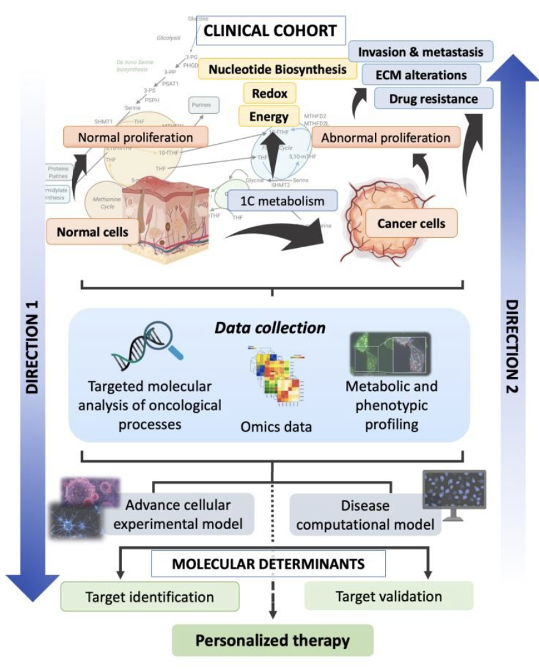
SPOKE 1 Holistic Nosology
PURPOSE OF THE SPOKE
Identify, in a large normal population and/or with specific pathologies (Big Killers), the factors that control/protect the development or progression towards distinct diseases, to be used as preventive/prognostic biomarkers and potential pharmacological targets for personalized medicine interventions.
The identified genes/molecules will be studied in vitro and in vivo (DIRECTION 1: from patients to molecular determinants). Furthermore, current knowledge on metabolic and biochemical pathways will be explored in depth, moving in the opposite direction (DIRECTION 2: from molecular determinants to patients).
direction 2
VALIDATE & USE
BioMARKERS
direction 1
IDENTIFY
BioMARKERS

Slide 4
SPOKE 1 Holistic Nosology
WP1. Population mapping: DNA seq, Exome Mapping aiming at the identification of pathogenic genetic variants
Task 1.1: Precision Medicine: the common soil hypothesis and the Moli-sani studies and other cohorts.
Task 1.2: Genomics, Phenomics and Biomarkers.
Task 1.3: Metabolome mapping from mouse to Moli-sani sub-cohorts and development of new therapeutic targets.
DNA
WP2. Transcriptomics: refinement of “common-soil” hypothesis & investigation on chronico-pathological conditions for personalized stratification for therapeutics
RNA
Task 2.1: Omics biomarkers in the stratification of obesity, epithelial and related metabolic and functional complications.
Task 2.2: Multi-omics approach for big killers: stratification of treatment response and tailored interventions.
Task 2.3: Serine metabolism and epigenetic regulation through ncRNAs.
WP3. Proteomic and metabolic analysis: an exciting avenue to advance the knowledge of dynamic interactomes
Task 3.1: Microbial metabolites impact on disease: from translational models to bedside.
Task 3.2: Protein degradation in physiology and pathology.
Task 3.3: Autophagy, cell cycle regulation and diseases.
Proteins
WP4. Metabolic alterations, metabolites and metabolome maps
Task 4.1: Long Chain fatty acids enzymes and lipid metabolism.
Task 4.2: Imaging & Ca2+ machinery as reporter of metabolic adaptations in physiology and disease.
Task 4.3: Genes versus environment, causing metabolic dysregulation leading to disease.
Metabolites

Slide 5
SPOKE 1 Holistic Nosology
Patient’s cohort: cancer
Patient’s cohort: end stage kidney diseases
CHOLANGIOCARCINOMA
100
Clinical info and follow-up
Trascriptomic in future
INTERMACS
registry
NHANES
Sex disparities in CKD
UO Verona
UO UNIVR
WHERE WE ARE( in month 18 of 36)
UO UNIVR
UO UNIVR
GASTRIC cancer
40
Clinical info and follow-up
Trascriptomic in future
Normal/Control
EQUAL
1725 multicenter cohort
Clinical info
Hemoglobin, erythropoietin, serum bicarbonate
24000
Clinical info
Genomic epigenomic analysis for 4000
Radiomic fron neuroimaging 3600
Selected samples for cardiovascular risk
UO UNIVR
UO UNIVR
96
Clinical info
DNA for WES ongoing
Plasma for metabolomic available
Cohorts dello SPOKE 1:
MOLI-SANI
UO NeuroMed
GENOMA SARDO
Pulmonary fibrosis
Patient’s cohort: inflammation
UO UNICA
GENOMA SARDO
Breast cancer
875
Clinical info
DNA for WES ongoing
Plasma for metabolomic available
PSORIATIC arthr.
163 treated TNFi
333
Clinical info
DNA for WES ongoing
Plasma for metabolomic available
UO UNITorverg
UO UNICA
GENOMA SARDO
n?
DNA for WES ongoing
Plasma for metabolomic available
UO UNICA
HIDRATENITIS S.
GENOMA SARDO
Hepatocellular
carcinoma
21
Clinical info
DNA for WES ongoing
Plasma for metabolomic available
UO UNIPVM
15 patients and 10 controls (fresh tissue)
UO UNICA
HIDRATENITIS S.
UO UNIPVM

Slide 6
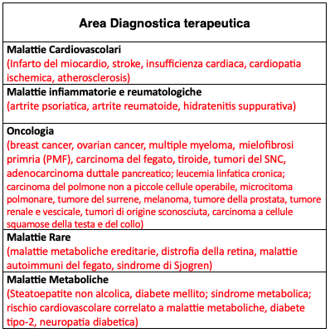
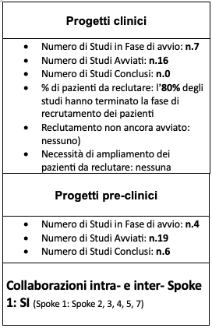
SPOKE 1 Holistic Nosology
Oral communications SPOKE 1:
Giuseppe NOVELLI
Genomics in Precision and Personalized Medicine: How the management of complex and multifactorial diseases changes.
Sebastiano RONTUAROLI
Multiomic Characterization of Clonal Dynamics in the Disease Progression of Myeloproliferative Neoplasms.
Gilulia GALLERANI
Circulating Tumor Cells: from Cancer Monitoring to Metastatic Models.
Massimiliano AGOSTINI
Models to Study Long Chain Fatty Acids Enzymes and Lipid Metabolism in Diseases.
Federica ROSSIN, UNI Tor Vergata
Role of Transglutaminase 2 in Hepatocarcinogenesis.
Sabrina GIGLIO
Liquid Biopsy into the Clinics: Current Evidence and Future Perspectives - Experience of Ovarian Cancer in the Sardinian Population.
WHERE WE ARE( in month 18 di 36)
Tot. 23
Tot. 29
Various scientific publications and participation in conferences

Slide 7
SPOKE 1 Holistic Nosology
WHERE WE ARE GOING:
Conclusion of ongoing projects;
Identification and characterization of -omics signatures associated with most of the diseases studied;
Identification of new markers for improving early diagnosis, prognosis and predictors of response to therapy;
Identification of new pathways relevant for the identification of new therapeutic targets.

Slide 8
SPOKE 1 Holistic Nosology
FORECASTS AFTER THE CLOSURE OF THE PROJECT
Improve public health. While GENOMICS already offers the possibility of obtaining rapid and personalized diagnoses, we believe we are contributing to establishing whether other OMICS sciences, such as PROTEOMICS and METABOLOMICS, will complete their transfer from research laboratories into clinical practice;
Demonstration that the INTEGRATION of OMICS SCIENCES in the clinic will act as a driving force for the development of systems medicine and this convergence of knowledge and data will allow us to understand the complexity of diseases and develop increasingly personalized programs;
Promote FUNDAMENTAL RESEARCH as a GENERATOR of new APPROACHES for prevention, screening, risk stratification, early diagnosis and precision therapies tailored to the phenotypes of defined diseases (cancer, cardiovascular, metabolic and rare diseases);
Creation of SYNERGY between universities and both public and private research institutions (networking, thematic networks, biobanks) for future projects and new challenges;
Creation of scientific SKILLS for the study of complex pathologies with advanced TECHNOLOGIES.

